Slide 1

BU Spark! Athletics
Nov 22

Slide 2
Agenda
Walk through all analysis
Student performance across different geographic areas
Schedule moving forward

Slide 3
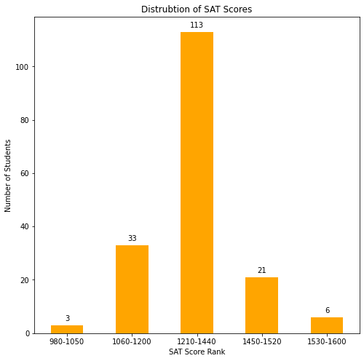
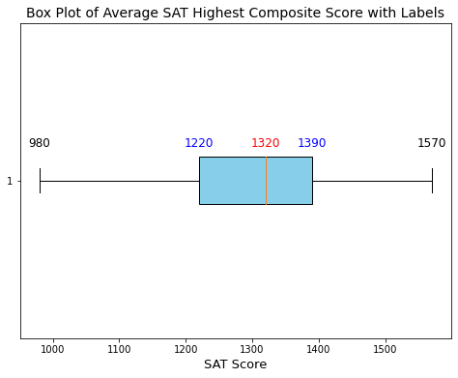
Question 1
What is the range of accepted SAT/ACT scores and high school GPA for student athletes?
The range of accepted SAT scores: 980-1570 (out of 1600)
176 out of 623 submitted SAT scores
3 students below national average (1050)
Median: 1320
50% students ranged from 1220-1390
6 students above national 95th percentile (1520)

Slide 4
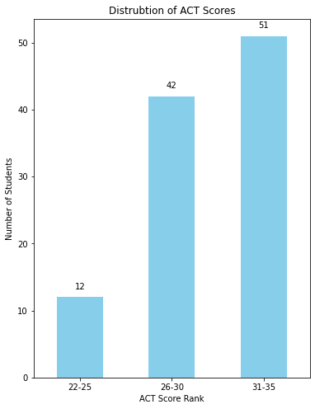
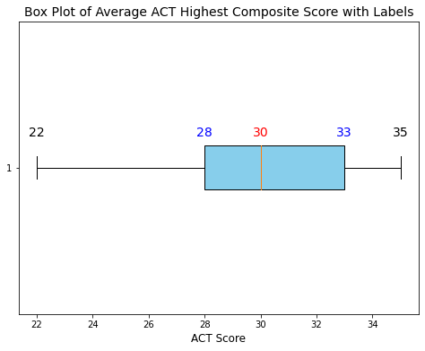
What is the range of accepted SAT/ACT scores and high school GPA for student athletes?
The range of accepted ACT scores: 22-35 (out of 36)
105 out of 623 students submitted ACT score
All BU athletes were above the national average (19.9)
Median: 30
50% students ranged from 28-33

Slide 5
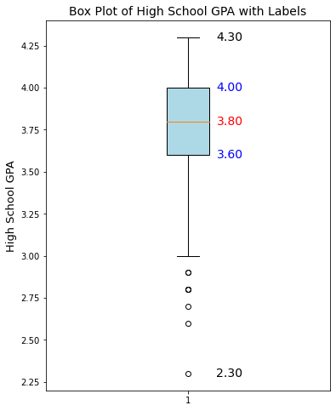
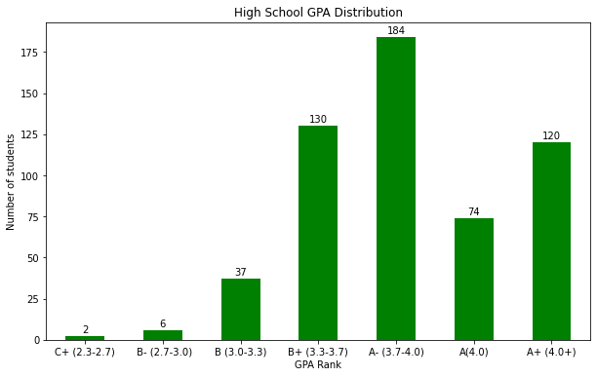
What is the range of accepted SAT/ACT scores and high school GPA for student athletes?
The range of accepted HS GPA: 2.3 - 4.3 (out of 4.5)
All accepted students have a HS GPA above C, 8 students listed as outliers (< 3.0)
Median: 3.8
50% students ranged from 3.6 - 4.0
Letter Grade | Percent Grade | 4.0 Scale
A+ | 97-100 | 4.0
A | 93-96 | 4.0
A- | 90-92 | 3.7
B+ | 87-89 | 3.3
B | 83-86 | 3.0
B- | 80-82 | 2.7
C+ | 77-79 | 2.3
C | 73-76 | 2.0

Slide 6
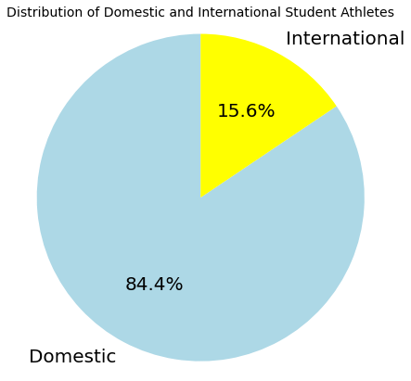
Question 1.1
What percentage of these student athletes are domestic students? What about international students?
Number of Domestic Students:
526 out of 623 (84.4%)
Number of International Students:
97 out of 623 (15.6%)

Slide 7
Question 1.2
Does English being the primary language of the country impact the students’ performance?
Approach:
Separate data into domestic and international students.
Compare the range, mean, median of BU GPA for each school year.
Compare the percentage of each GPA rank between domestic and international students.
Key Insight:
English being the primary language MAY NOT significantly impact the long-term academic performance. From short-term aspect, international students might need a longer period of adjustment to new educational system (college).

Slide 8
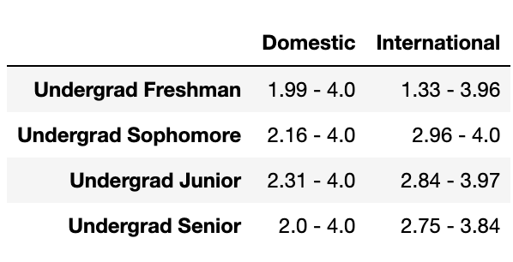
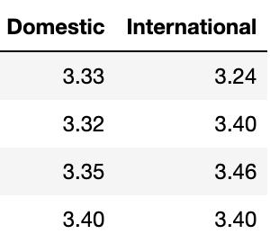
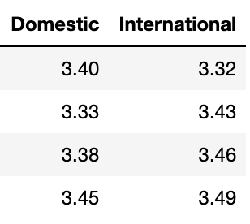
Does English being the primary language of the country impact the students’ performance?
Mean, median of BU GPA for each school year
Freshman year: domestic students generally performs better
Sophomore - Senior year: international students generally performs better
Mean
Median
Notes:
Domestic students: generally wider GPA range (higher variability), Undergrad Freshmen show the greatest disparity. Variability tends to decrease with advancing class year for both groups (period of adjustment).

Slide 9
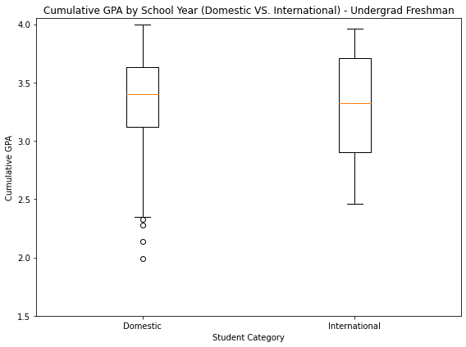
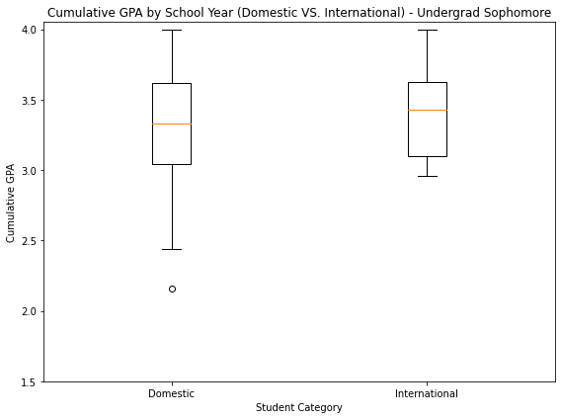
Does English being the primary language of the country impact the students’ performance?
Range of BU GPA for each school year
Generally higher variability for domestic students
Outliers in the low range of GPA
Wider interquartile range for domestic students
Range
Freshman
Sophomore
Notes:
Domestic students: generally wider GPA range (higher variability), Undergrad Freshmen show the greatest disparity.
The presence of these lower outliers may suggest a wider spread in academic performance among domestic students.
The interquartile range (IQR) for domestic students appears slightly wider in some plots, further emphasizing a larger spread in GPA distribution for domestic students.
Variability tends to decrease with advancing class year for both groups (period of adjustment).

Slide 10
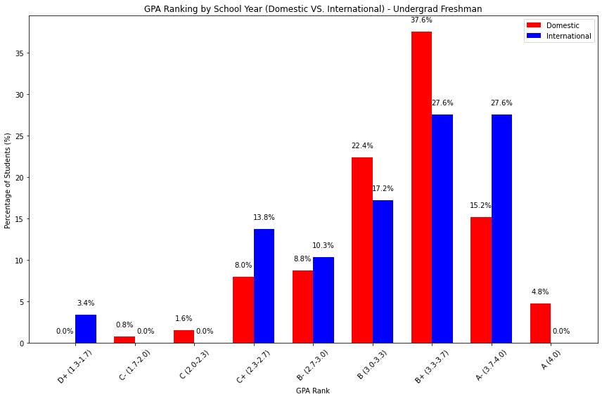
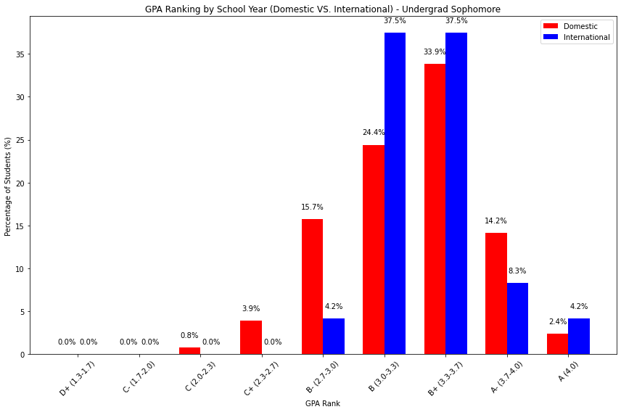
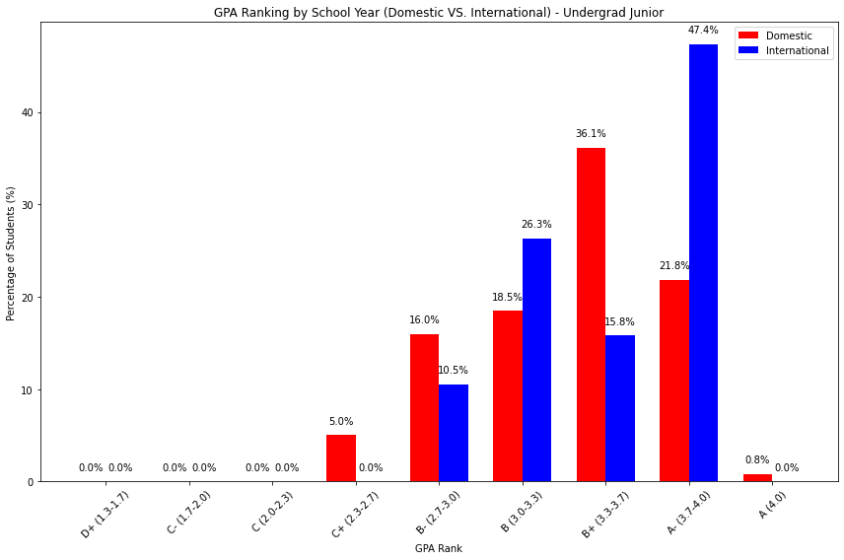
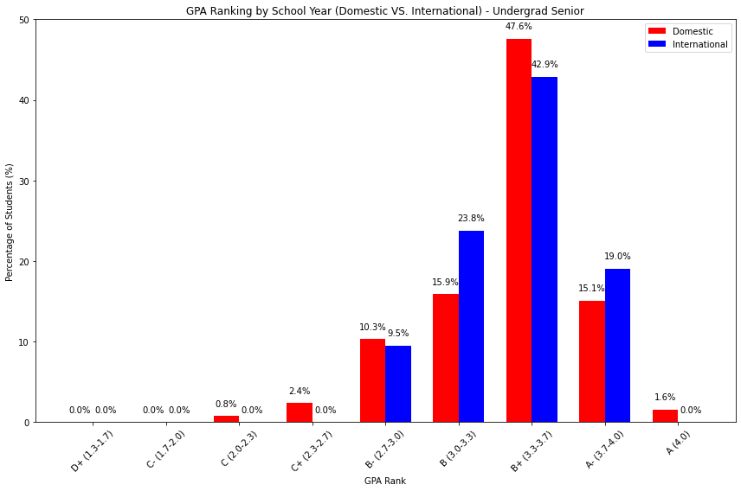
Does English being the primary language of the country impact the students’ performance?
Freshman
Sophomore
Percentage of each GPA rank for each school year
Generally similar in distribution. Sometimes international students perform better in higher GPA ranks.
Junior
Senior
Notes:
domestic-red, international-blue
(Junior, A- rank, 47.4% VS 21.8%)
In short term, we did see the impact: 3.4% international students having D+

Slide 11
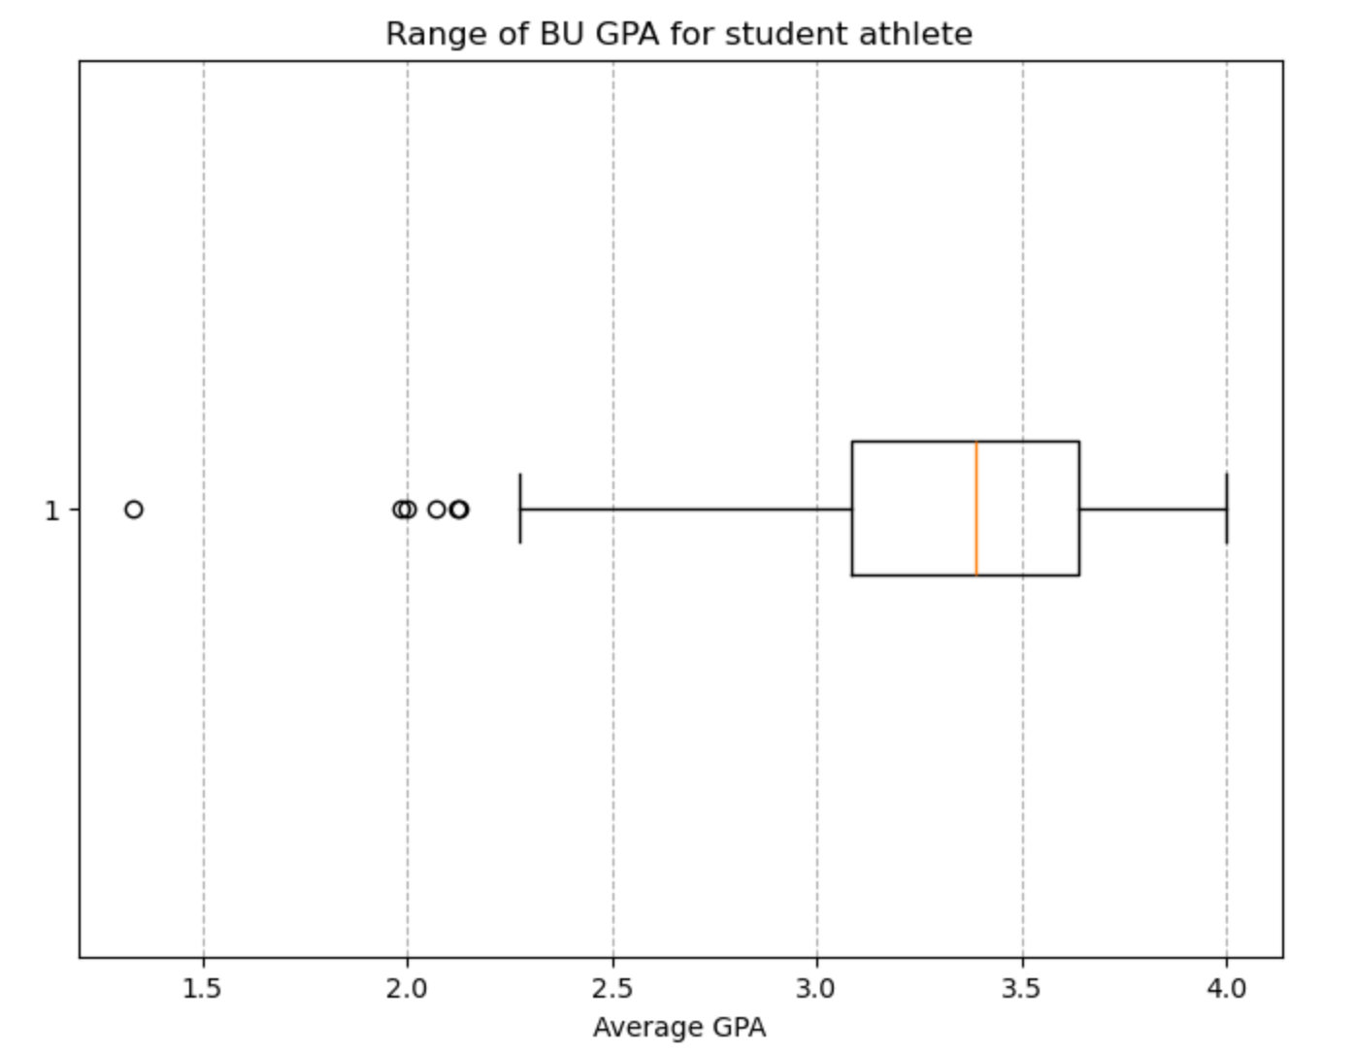
Question 2
What is the range of BU gpa for student athletes
Minimum BU GPA for student athletes: 1.33
Maximum BU GPA for student athletes: 4.0
GPA Range: [1.33, 4.0]

Slide 12
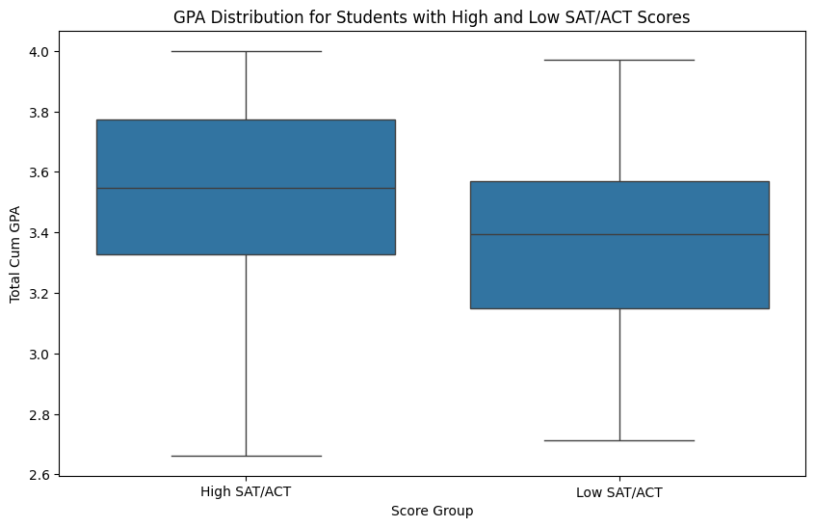
Question 3
How do these students with high SAT/ACT scores or high GPA perform academically at BU compared to student athletes with low SAT/ACT scores or low GPA?
High SAT/ACT Scores Group:
Median: 3.55
1st Quartile (Q1): 3.33
3rd Quartile (Q3): 3.77
Mean: 3.47
Standard Deviation: 0.43
Low SAT/ACT Scores Group:
Median: 3.39
1st Quartile (Q1): 3.15
3rd Quartile (Q3): 3.57
Mean: 3.35
Standard Deviation: 0.34

Slide 13
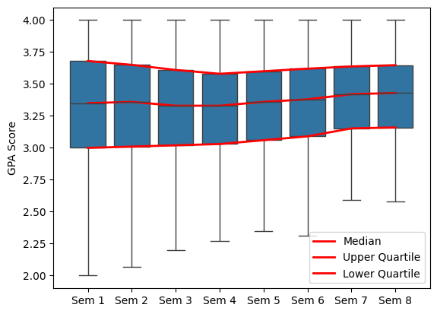
Question 4
Does the average student athlete improve their GPA throughout their college years?
Lower Quartile GPA
Lowest GPA
Semester 1: 3.00
Semester 2: 3.01
Semester 3: 3.02
Semester 4: 3.03
Semester 5: 3.06
Semester 6: 3.09
Semester 7: 3.15
Semester 8: 3.16
Semester 1: 1.10
Semester 2: 1.57
Semester 3: 1.86
Semester 4: 2.16
Semester 5: 2.35
Semester 6: 2.31
Semester 7: 2.30
Semester 8: 2.29

Slide 14
Question 5
Do students from certain geographic areas perform better academically than other geographic areas?
Approach:
For domestic students, group the students by their home admission regions
For international students, group the students by their region of citizenship
Compare the latest cumulative GPA
Key Insight:
Domestic students: students from South and Pacific generally perform better, while students from Southwest may need potential academic support
International students: students from Baguette and Wheat generally perform better, while students from Ciabatta may need potential academic support

Slide 15
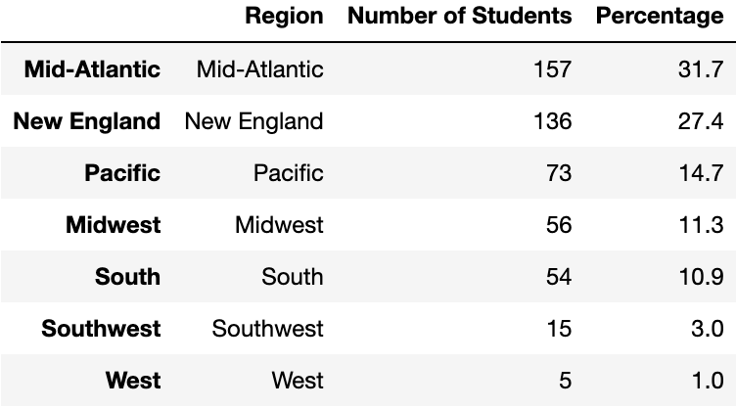
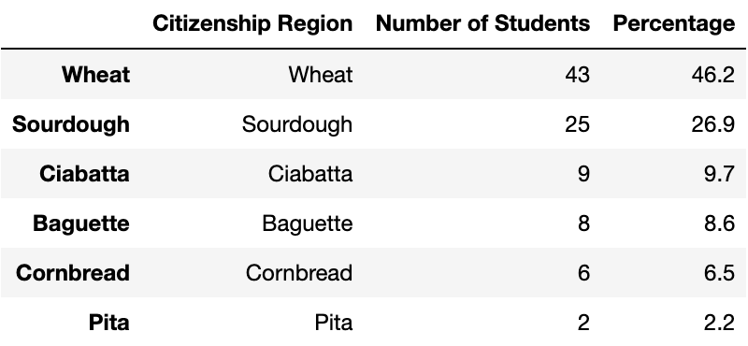
Do students from certain geographic areas perform better academically than other geographic areas?
How students are distributed geographically
Domestic
International
Notes:
Number of Domestic Students: 526
Number of International Students: 97

Slide 16
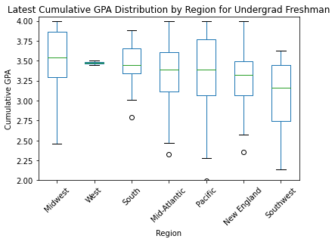
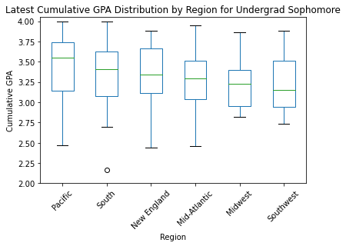
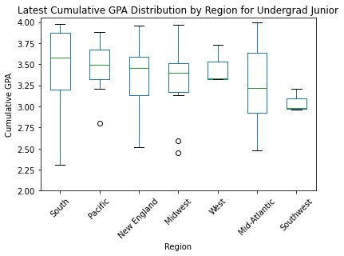
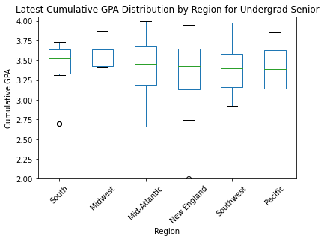
Students from South regions generally perform better academically
The Pacific area also shows strong performance in Sophomore and Junior year
The Southwest region tends to have the lowest median GPA
Notes:
Students from the Midwest and South regions generally perform better academically, with consistently high median GPAs across years. The Pacific also shows strong performance. In contrast, the Southwest region tends to have the lowest median GPAs, suggesting a potential need for academic support.
Midwest: best in freshman year
South: best in Junior and senior year, but also shows great variability in junior year
Pacific: also shows astonishing performance in sophomore, generally shows greater variability in freshman, sophomore
Southwest: generally performs worse, consistently the lowest in median
Mid-Atlantic, South: great variability (especially south for junior year)
Junior year: high variability (with outliers)

Slide 17
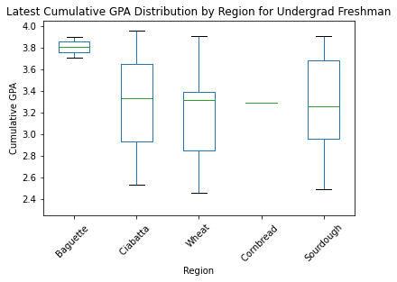
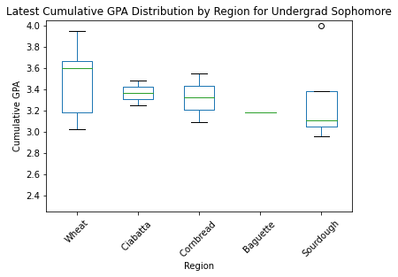
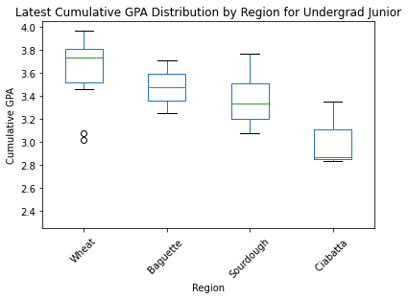
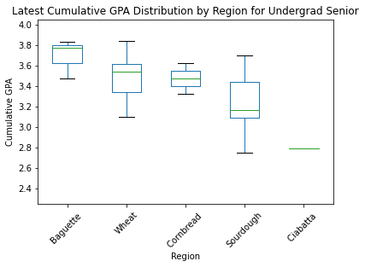
Students from Baguette and Wheat regions generally perform better academically
The Ciabatta region shows strong performance in Freshman and Sophomore year, but turns into region with lowest median GPAs in Junior and Senior year
Notes:
International students from the Baguette and Wheat regions appear to perform better academically, with high median GPAs and consistent performance across years.
In contrast, students from Ciabatta show strong performance in first two years, but drop to region with the lowest median GPAs in the last two year, suggesting that they may need additional academic support for Junior and Senior year.
Cornbread and Sourdough regions show moderate performance, students from these regions are achieving respectably but not as high as those from Baguette and Wheat.
Look at individual region
Wheat: the median line tend to be left-skewed, lower values are more spread out
Pita: incomplete data, difficult to analyze
Cornbread: consistent moderate performance
Sourdough: worse than cornbread, relatively lower performance, median line right-skewed, higher values are more spread out, more data concentrated at lower values, especially sophomore year, outliers on top (exceptional high performers)

Slide 18
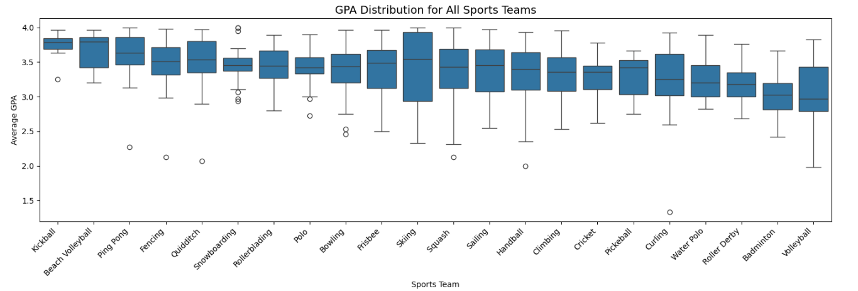
Question 6
Are there any significant differences in the academic performance of student-athletes based on their sport?
p-value: 0.0000000000005
one-way ANOVA
significant difference exist in academic performance among different sport teams (p<0.05)

Slide 19
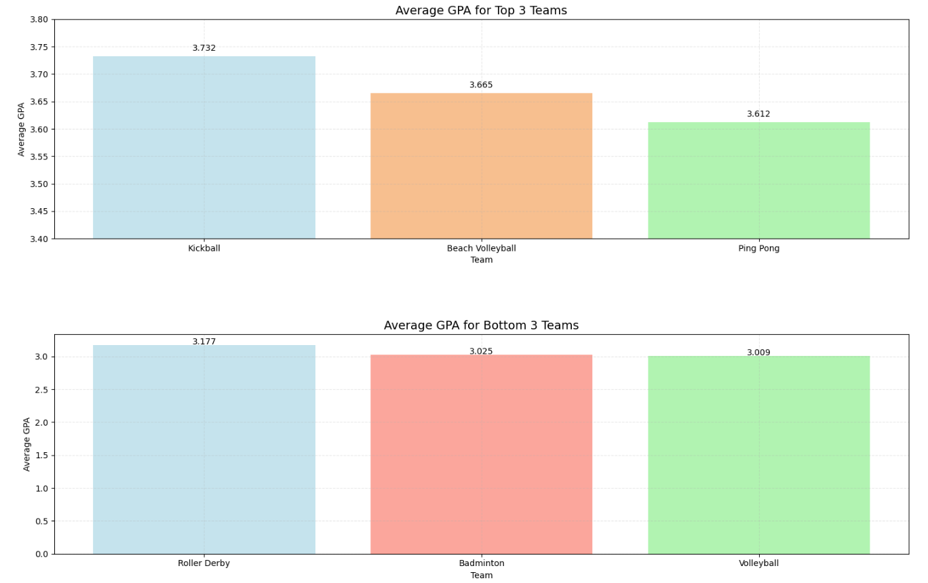
Question 6
Are there any significant differences in the academic performance of student-athletes based on their sport?
Top 3 Performing Sport Teams
Sport | Mean GPA | 75% above | Count
Kickball | 3.732 | 3.691 | 8
Beach Volleyball | 3.665 | 3.421 | 10
Ping Pong | 3.612 | 3.467 | 30
Bottom 3 Performing Sport Teams
Sport | Mean GPA | 75% below | Count
Roller Derby | 3.177 | 3.350 | 29
Badminton | 3.025 | 3.198 | 58
Volleyball | 3.009 | 3.430 | 17

Slide 20
Additional Question
Find if there are trends or correlation with two or more variables (e.g. Do students from certain geographic areas with higher HS GPA perform better throughout their college)
Approach:
For each region and school year (from High School to Senior), compare the median GPA
Key Insight:
While not definitive, the graphs suggest that generally, students entering college with higher high school GPAs are more likely to perform well in college, as reflected in their higher college GPAs.

Slide 21
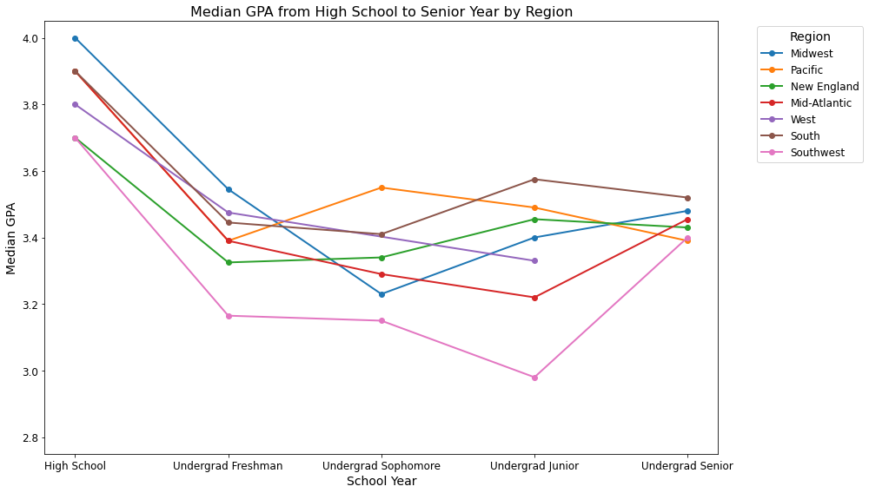
Find if there are trends or correlation with two or more variables (e.g. Do students from certain geographic areas with higher HS GPA perform better throughout their college)
Domestic Students
 | HS | Freshman | Sophomore | Junior | Senior
Midwest | 4.0 | 3.545 | 3.23 | 3.400 | 3.480
Pacific | 3.9 | 3.390 | 3.55 | 3.490 | 3.390
Mid-Atlantic | 3.9 | 3.390 | 3.29 | 3.220 | 3.455
South | 3.9 | 3.445 | 3.41 | 3.575 | 3.520
West | 3.8 | 3.475 | / | 3.330 | /
New England | 3.7 | 3.325 | 3.34 | 3.455 | 3.430
Southwest | 3.7 | 3.165 | 3.15 | 2.980 | 3.400
Notes:
From q5, we conclude that students from South region generally perform the best, while students from Southwest region generally perform the worst. Right here, we can see that HS GPA does have certain impact on their college performance. (South region has the second highest HS GPA while Southwest has the lowest HS GPA).
This indicates that HS GPA could be a useful predictor of college success, but additional factors should be noticed, especially the sample size. For example, we only have 15 samples from Southwest and that could be one of the reasons for the relatively bad overall academic performance.
Also, as the line graph shows a big drop from HS GPA to College GPA, this is largely due to the different scales of GPA used in HS and College (4.5 GPA scale for HS, capped to 4.0 for simplicity, but still generally raise the average HS GPA)
Other than that, factors like(e.g., access to resources, institutional support, or cultural adaptability) might also play a significant role in student outcomes.
p-value (domestic only)

Slide 22
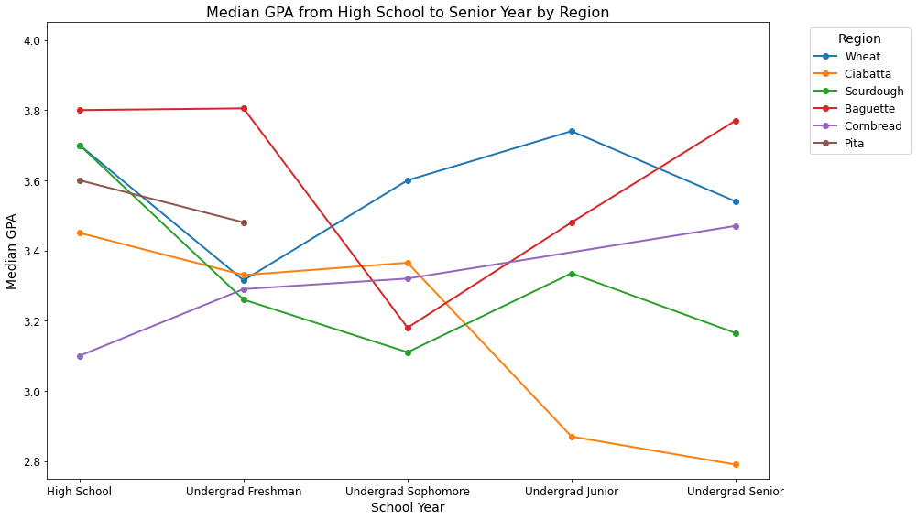
Find if there are trends or correlation with two or more variables (e.g. Do students from certain geographic areas with higher HS GPA perform better throughout their college)
International Students
 | HS | Freshman | Sophomore | Junior | Senior
Baguette | 3.8 | 3.805 | 3.180 | 3.480 | 3.770
Wheat | 3.7 | 3.315 | 3.600 | 3.740 | 3.540
Sourdough | 3.7 | 3.260 | 3.110 | 3.335 | 3.165
Pita | 3.6 | 3.480 | / | / | /
Ciabatta | 3.45 | 3.330 | 3.365 | 2.870 | 2.790
Cornbread | 3.1 | 3.290 | 3.320 | / | 3.470
Notes:
lack of data, less accurate
Baguette and Wheat: generally perform better (have higher HS GPA)
Ciabatta: perform worse and worse (has the second lowest HS GPA)
Still can’t conclude that HS GPA is a definite factor in impacting GPA because of the sample size:
Baguette: 8 while Wheat: 43 (the sudden drop in Sophomore year in Baguette could due to lack of sample), the Wheat data reflects more near to true circumstances)
Ciabatta: 9

Slide 23
Blockers
Lack of data

Slide 24
Future steps
Next Meeting Time: Dec. 6 (Final Client Meeting)
Before Final Meeting:
Complete final report
Work on Feedback from today’s meeting
Notes:
Is it possible to do more interactions of two variable comparison?
– Get the statistical significance for each of those models
– She liked the geographic for domestic. See if you can add sports.
– Not as meaningful using the GPA since they already know a lot of one variable but variable interactions.
– SAT/ACT isn’t important since they don’t require it anymore

Slide 25

Thank you!

